Slide 1
Unified Health Support Application

Slide 2
Problem Statement:
Access to health information, mental health support, and record management is limited, especially in rural areas with poor internet.
This project aims to develop a unified AI-powered app providing health awareness, student mental health support, and EHR management for ASHA workers with offline access and secure data handling.

Slide 3
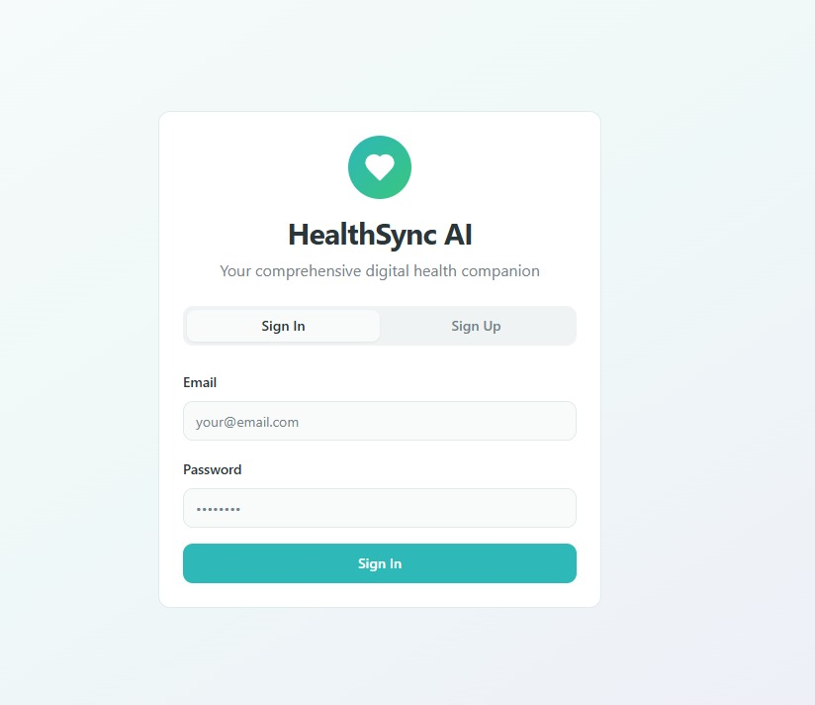

Slide 4
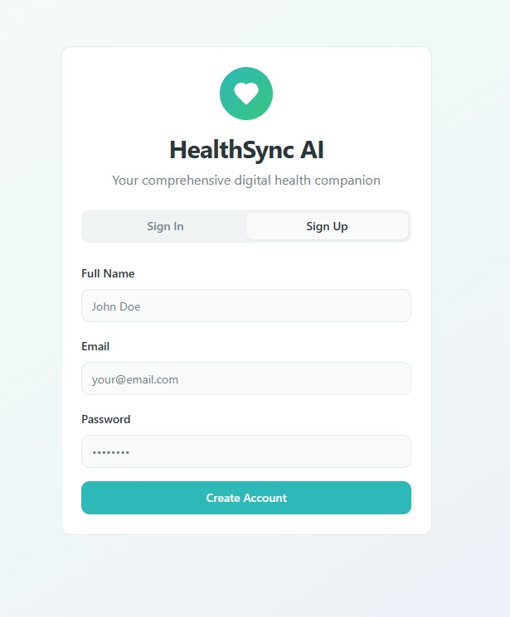

Slide 5
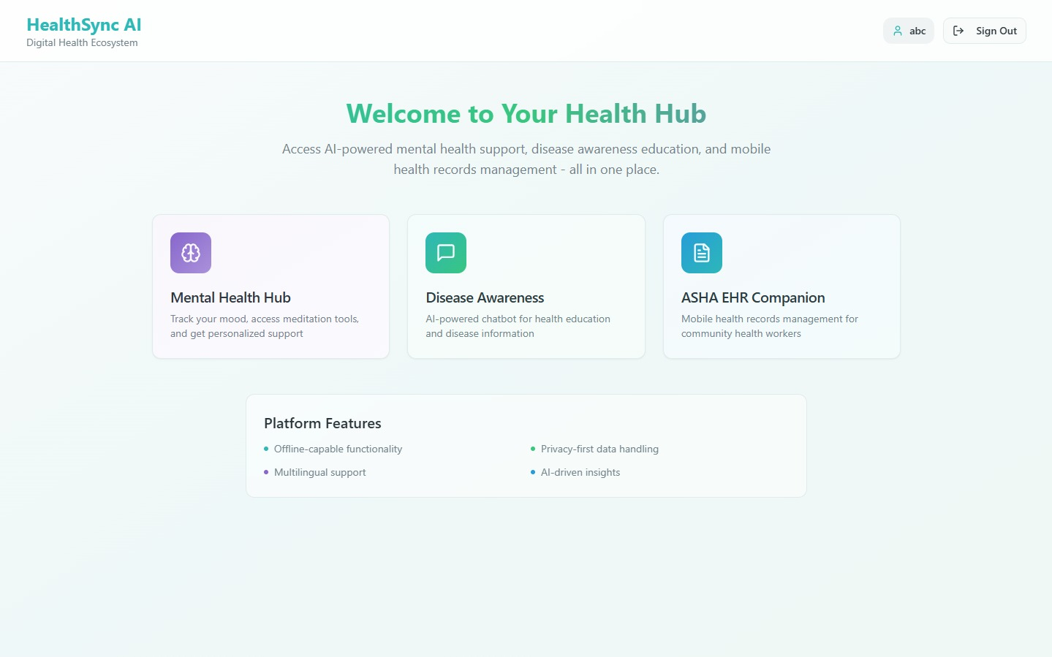

Slide 6
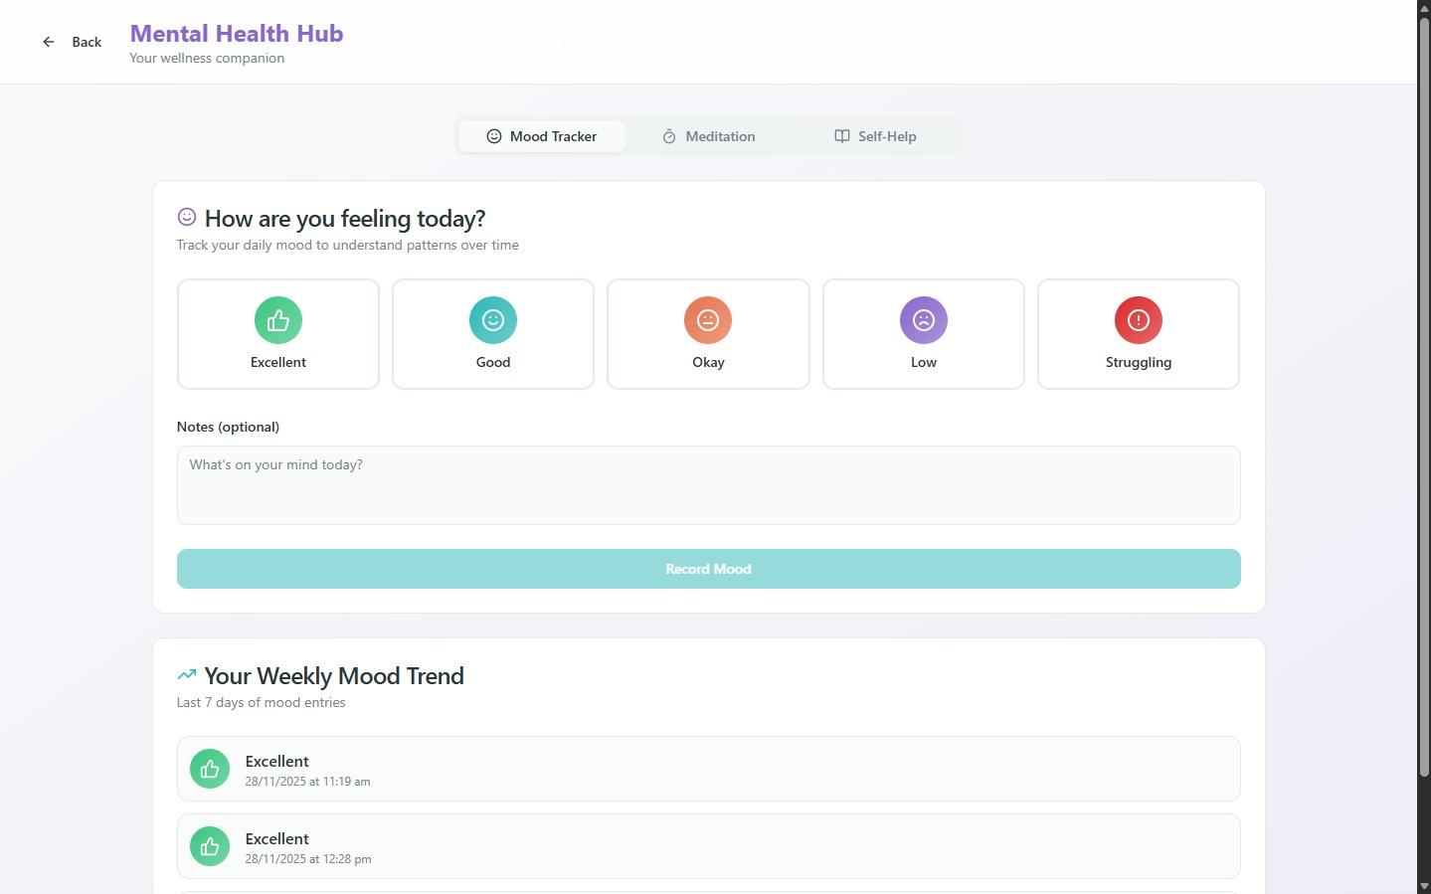

Slide 7
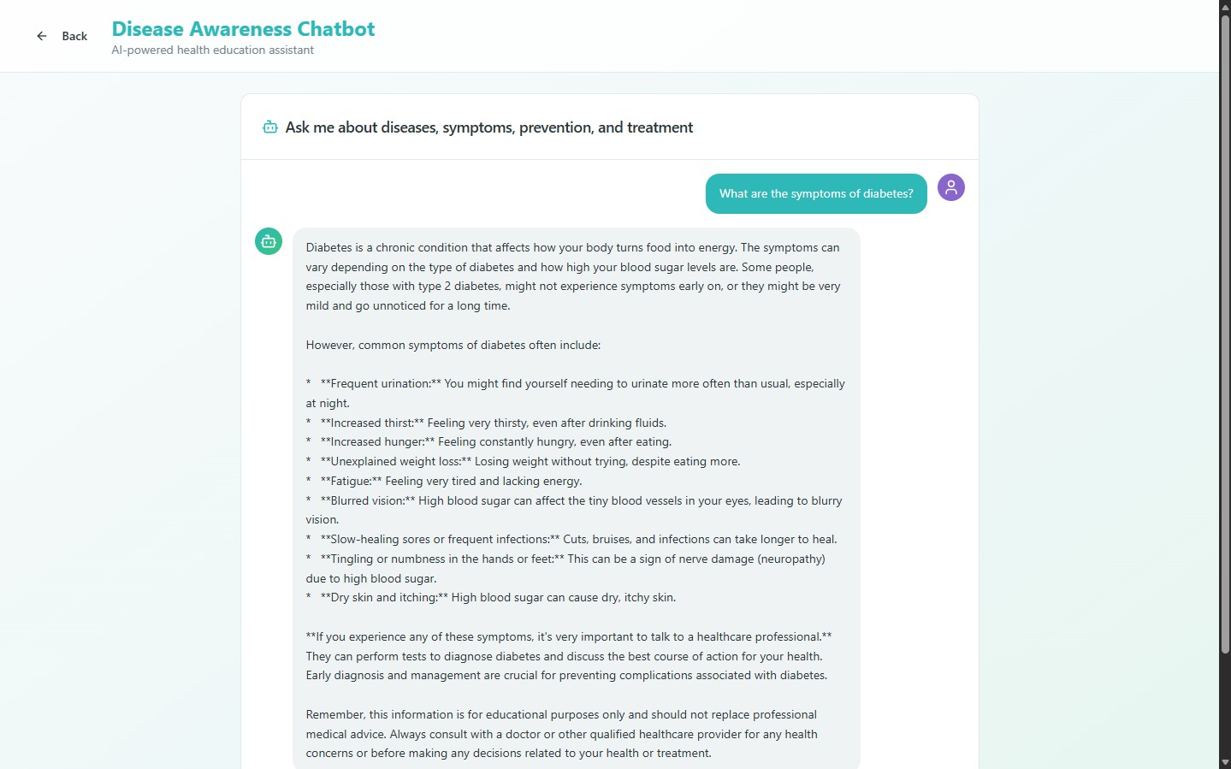

Slide 8
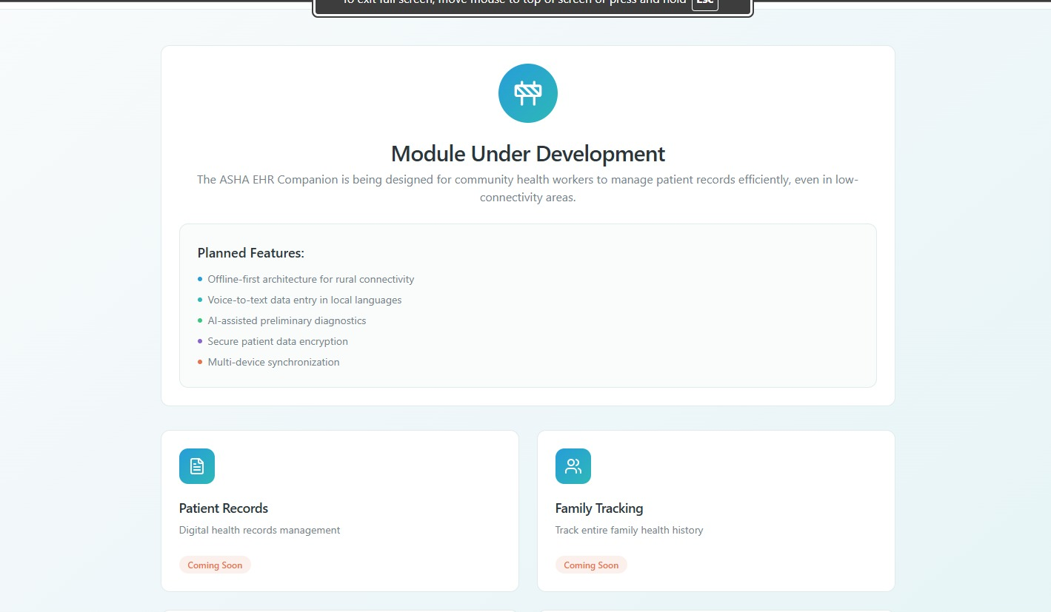

Slide 9
Thank you!

